Slide 1
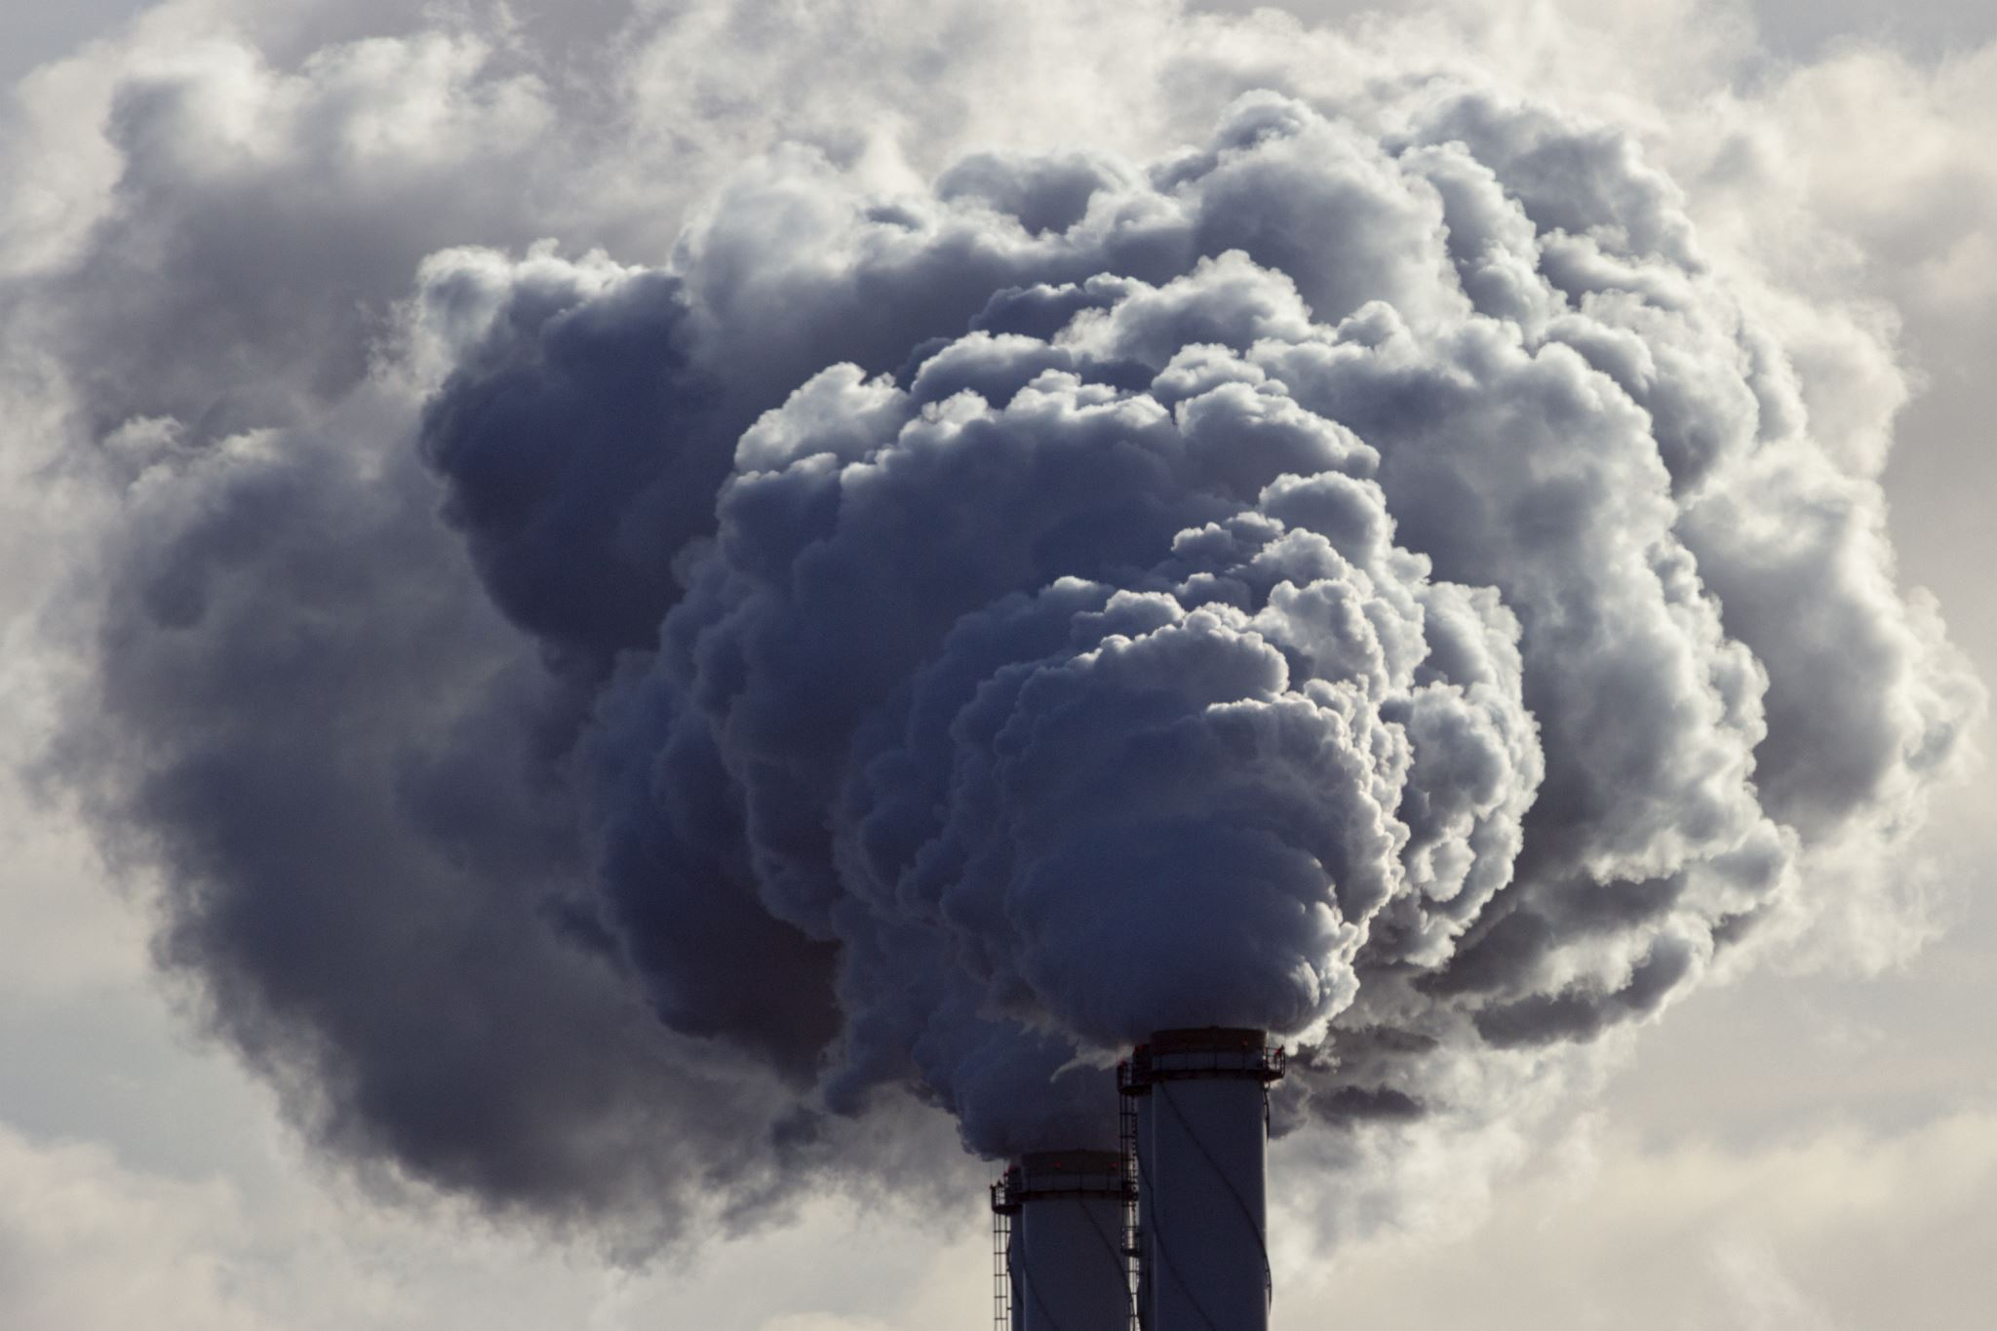
AIR POLLUTION AND RESPIRATORY DEATHS IN TURKEY
Yusuf Eren Akgün
Berçin Saba Güngör
İdil Güler
Muhammed Arda Akkan
Furkan Emre Güler

Slide 2

1st step: Finding Data
2nd step: Data Analysis
3rd step: Data Visualization
4th step: Hypothesis Testing

Slide 3

1ST STEP: FINDING DATA

Slide 4


OUR SOURCES:
TC Ministry of Environment, Urbanisation and Climate Change
TUIK (Türkiye Statistical Institute)

Slide 5
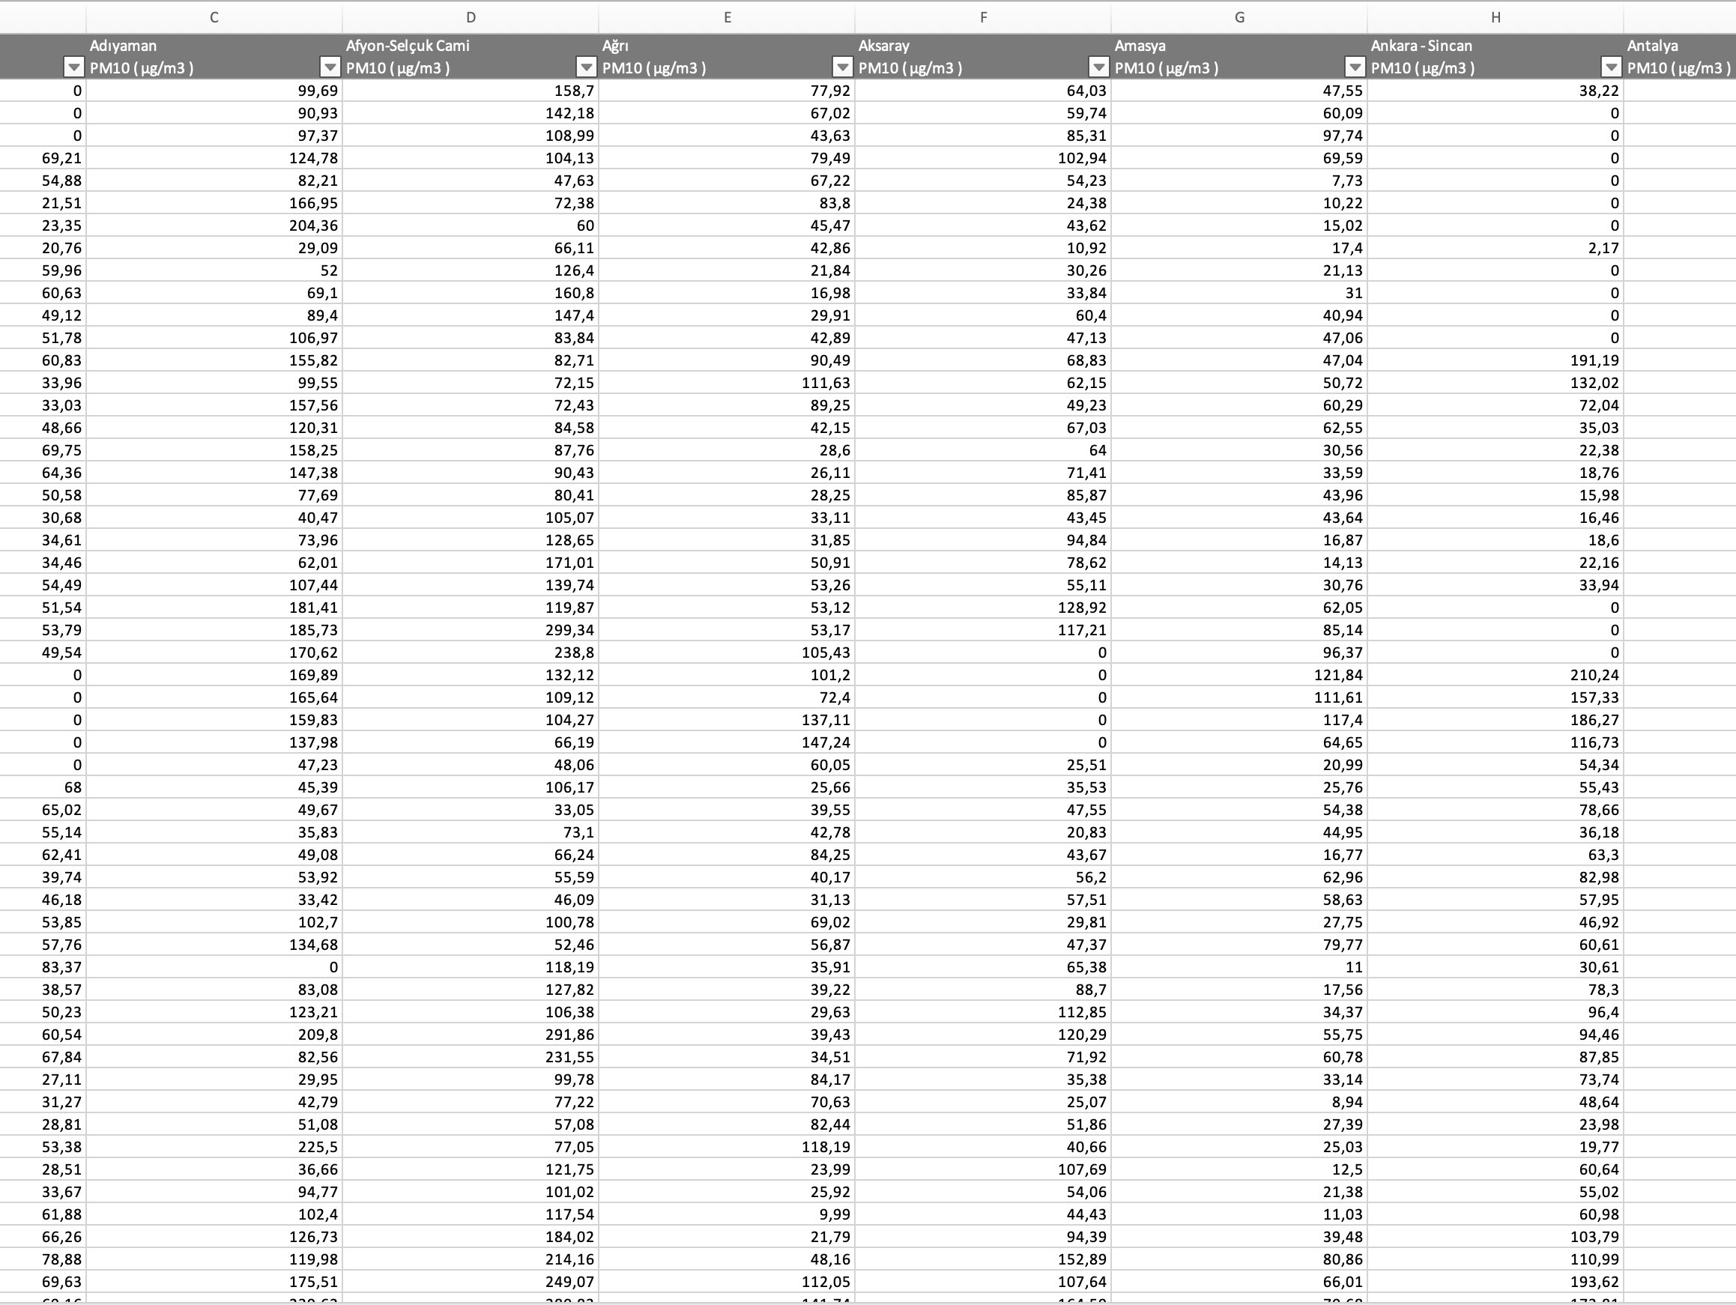
1st Dataset:
Air Pollution Rates
Year by year (2009-2017)
City by city
Retrieved from: TC Ministry of Environment, Urbanisation and Climate Change

Slide 6
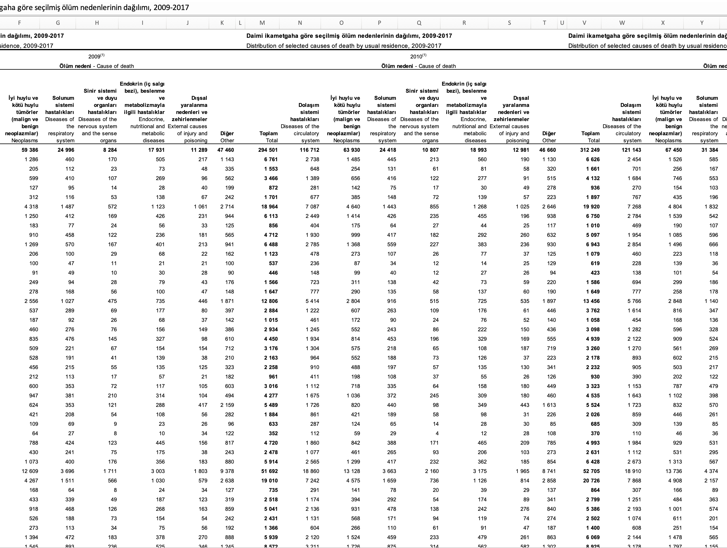
2nd Dataset:
Distribution of causes of death
Year by Year (2009-2017)
City by City
Retrieved from: TUIK (Türkiye Statistical Institute)

Slide 7
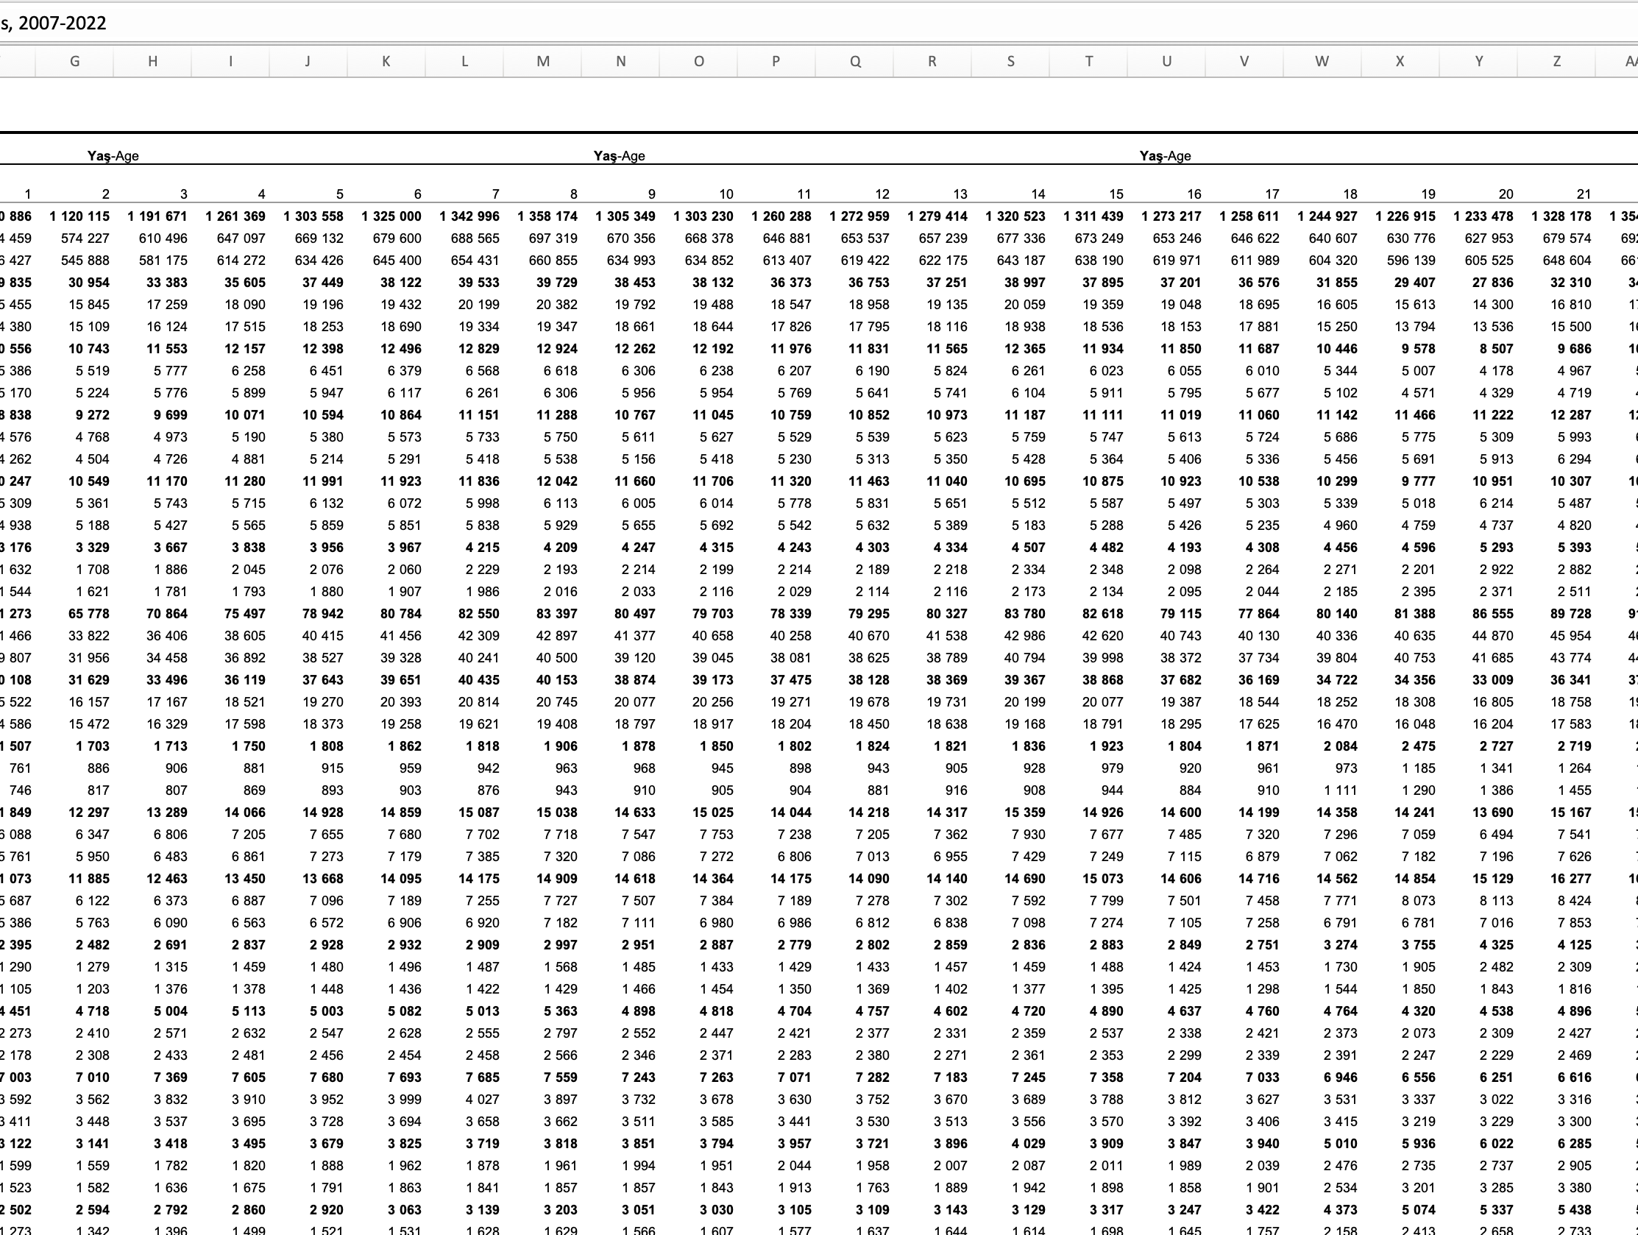
3rd Dataset:
Population distribution of provinces
Year by Year (2007-2022)
City by City
Retrieved from: TUIK (Türkiye Statistical Institute)

Slide 8

2nd STEP: EXploratory DATA ANALYSIS

Slide 9

CREATING DATA FRAMES:

Slide 10
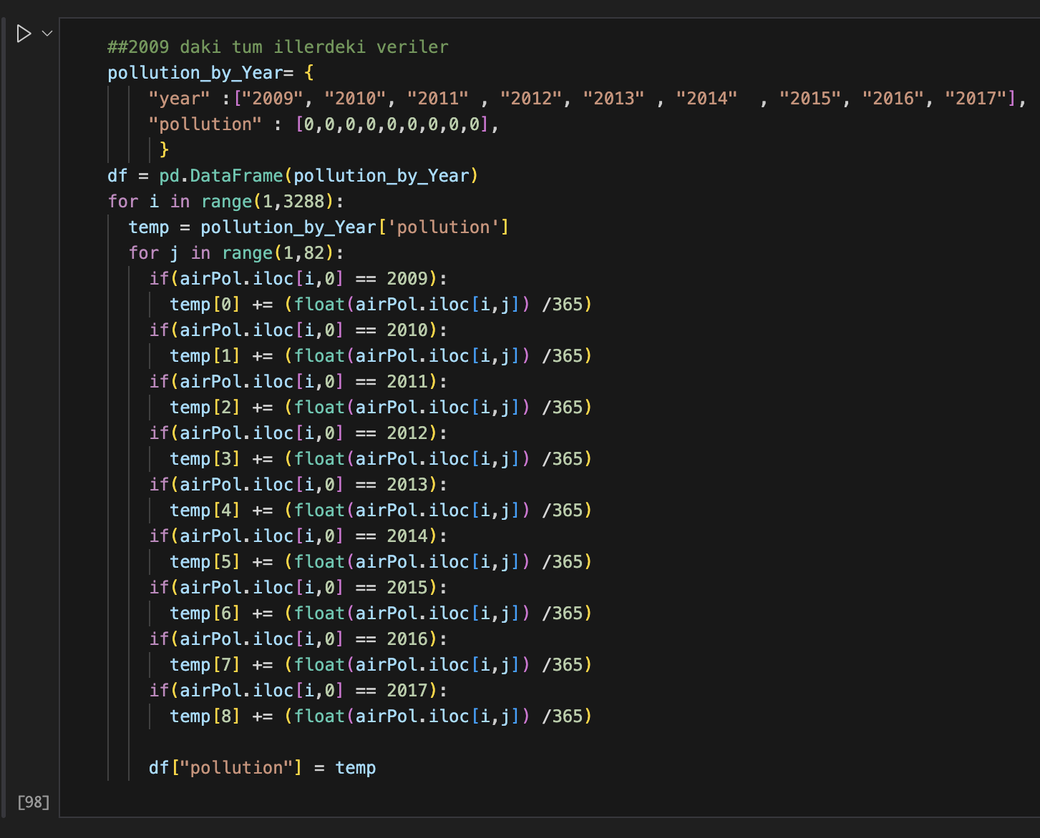
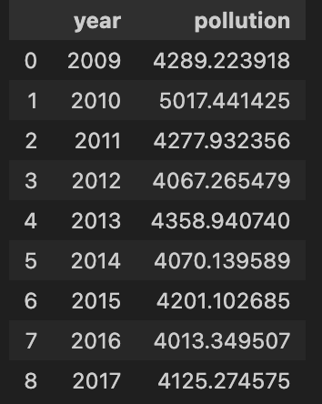
OUTPUT:

Slide 11
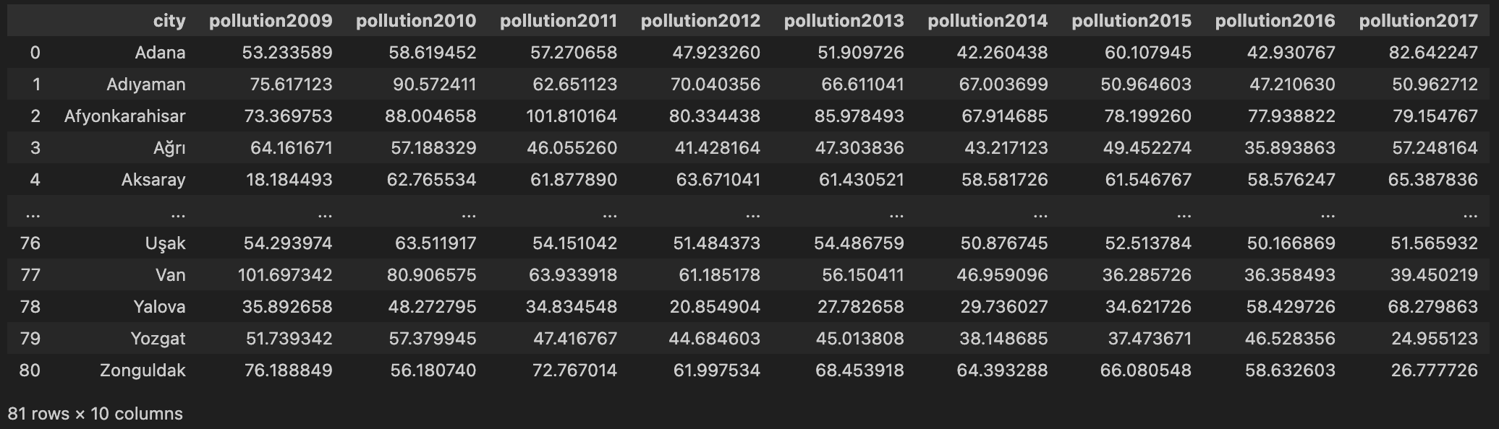
Pollution Data Frame:

Slide 12
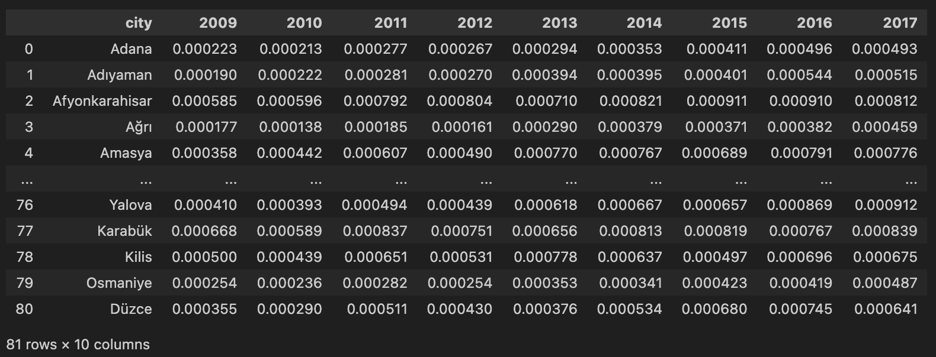
Death / Population Rate:

Slide 13

3rd STEP: DATA VISUALIZATION

Slide 14
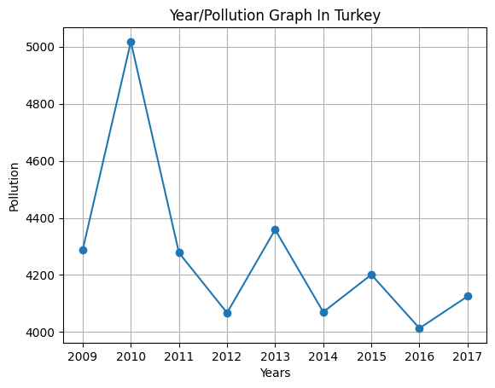
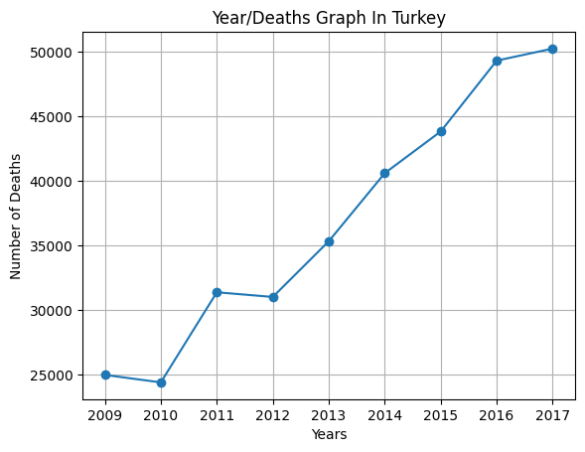

Slide 15
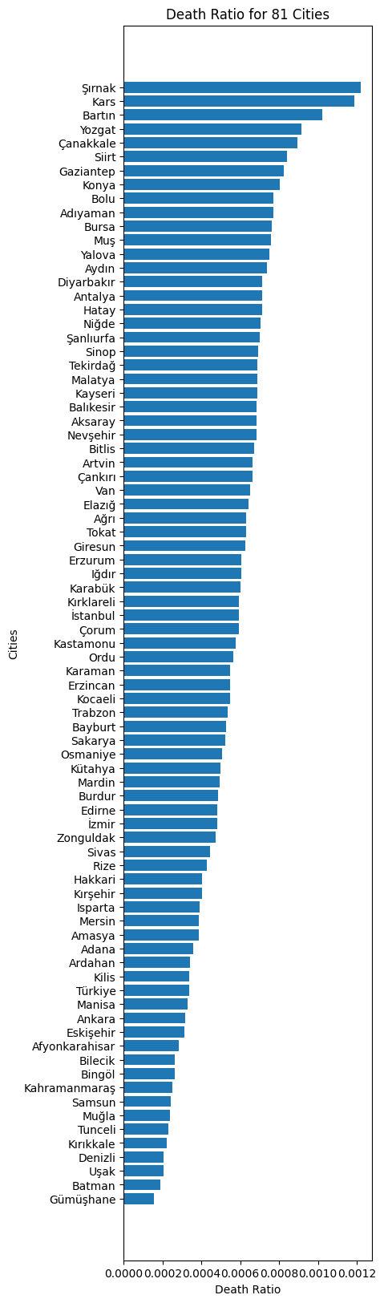
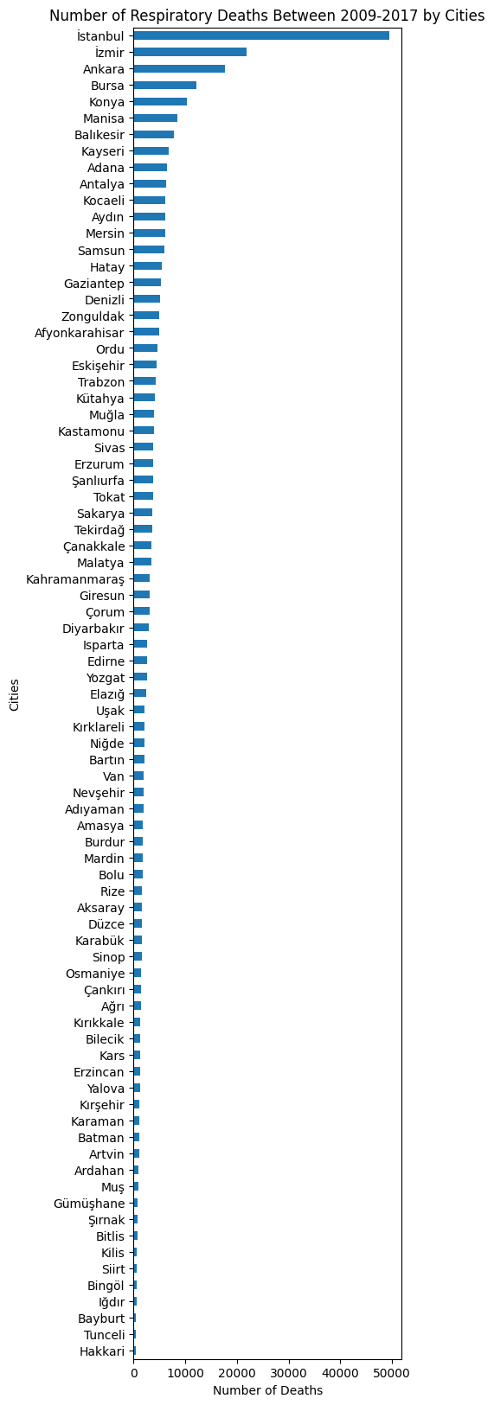
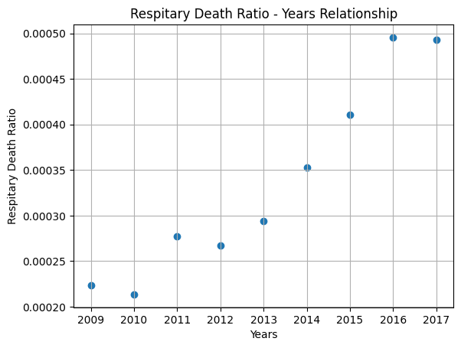

Slide 16

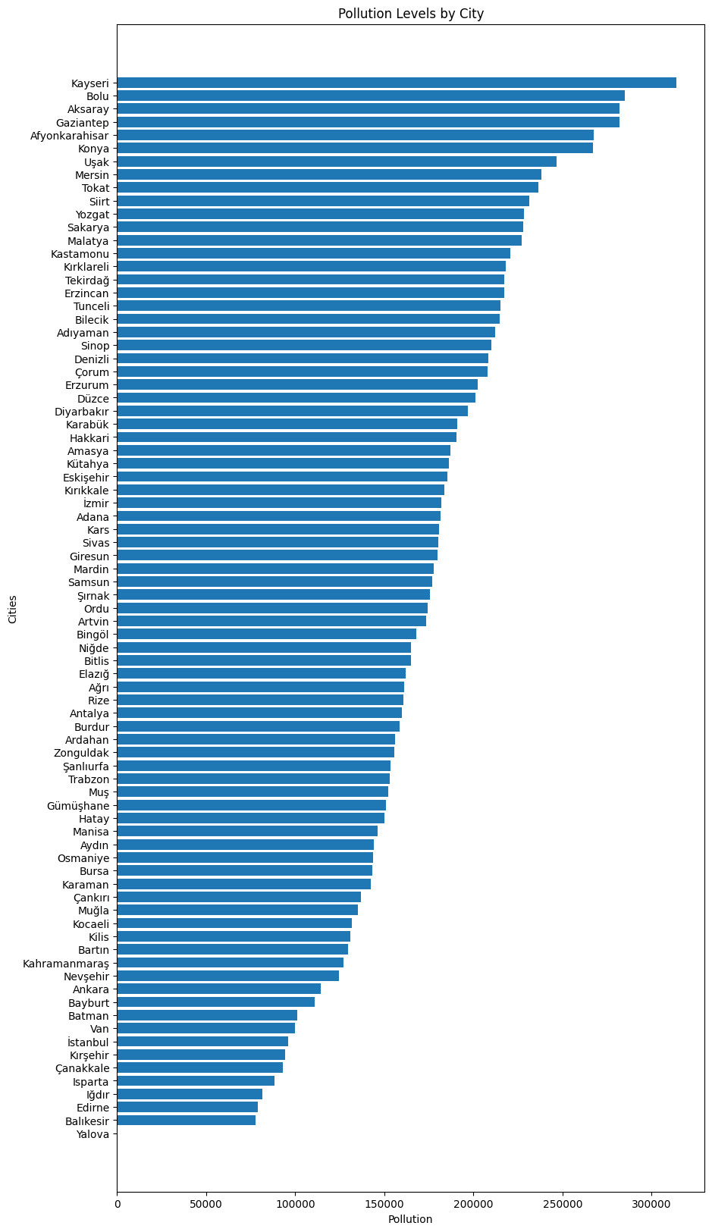
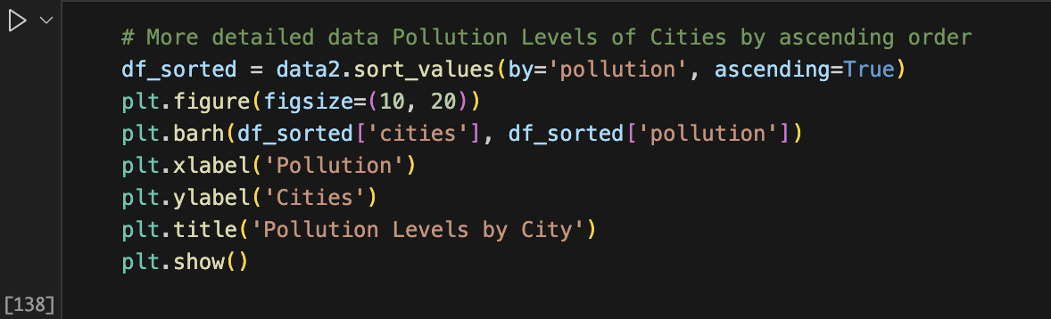

Slide 17

4th STEP: HYPOTHESIS TESTING

Slide 18
H0 : There is no significant relationship between air pollution and respiratory related deaths in Turkey in 2009-2017. Ha: There is a signigicant relationship between air pollution and respiratory related deaths in Turkey in 2009-2017. .

Slide 19
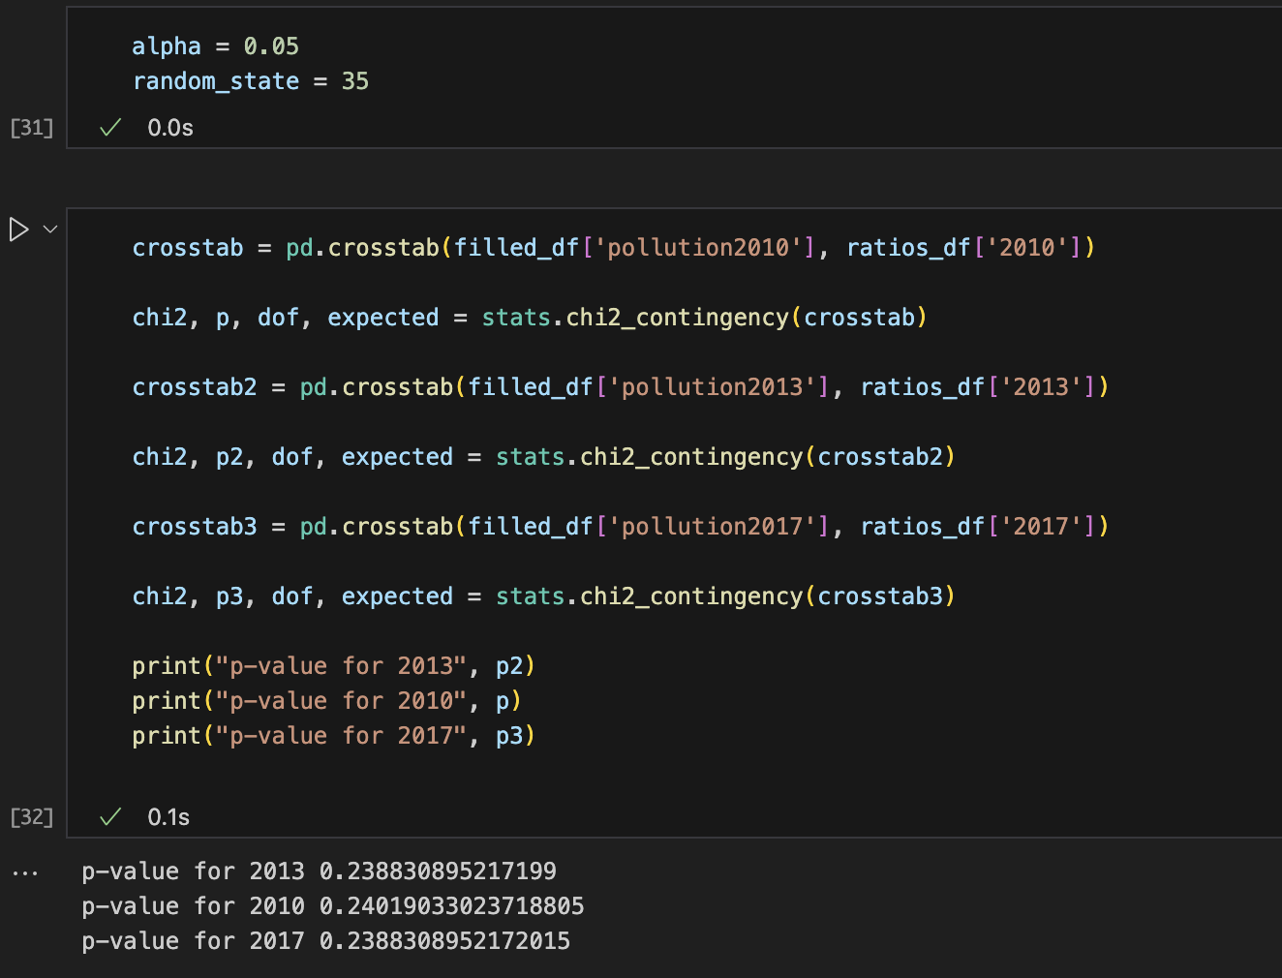

Slide 20
Conclusion: We cannot reject Null Hypothesis.

Slide 21
Thank you for listening ☺

